Slide 1
DS Average Salary for the State of FL
The data scientist job market has current variability due to conditions arising from the Covid 19 pandemic
The transfer of companies from other states to Florida could influence the behavior of this DS job market.
Our Goal: We want to predict the salary behavior of data scientists in the state of Florida based on the opening of new positions and the skills of the applicants.

Slide 2
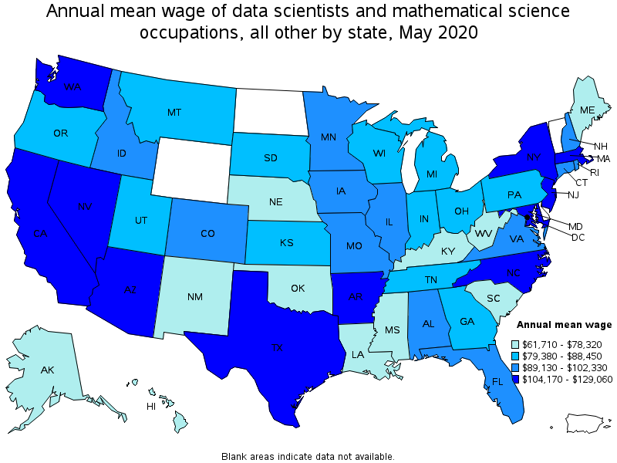
From U.S. BUREAU OF LABOR STATISTICS
https://www.bls.gov/oes/current/oes152098.htm

Slide 3
Who care about salary variation?
Every job seeker. Any company.
Especially for me it was important to know the variations of salaries in DS between the States and their possible causes, as well as the States and cities that offer the most opportunities.

Slide 4
Possible factors affecting salary
In this 2021, the labor market in general suffers contractions at the beginning of the year. In recent months due to the improvement of the situation with the covid, a recovery of jobs is beginning and specifically in the state of Florida, it is observed that a small increase in Data Scientist positions may occur and we expect an increase higher at the end of the year.
The causes in general can be different, the movement of companies from the North and West to the East could be one of them, which would lead to an increase in jobs, but we also know that there are other factors such as personal skills that can influence increase in average wages.

Slide 5
Exploratory Data Analysis and Initial Findings
Initially I could see that the state of Texas represents a good niche of opportunities.
Also of the 30 cities that offer the most DS jobs, 9 are from Texas and 9 from California, which represents 60%. 4 From Arizona (0.13%) and the rest from other states.

Slide 6
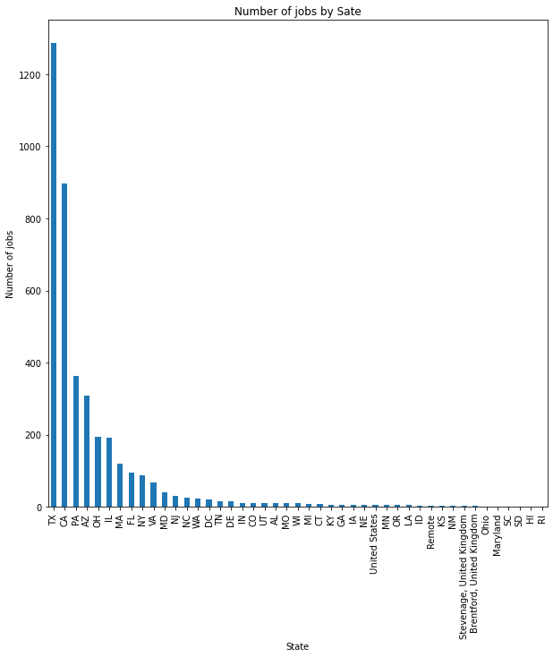
Jobs per State (First 30 States)

Slide 7
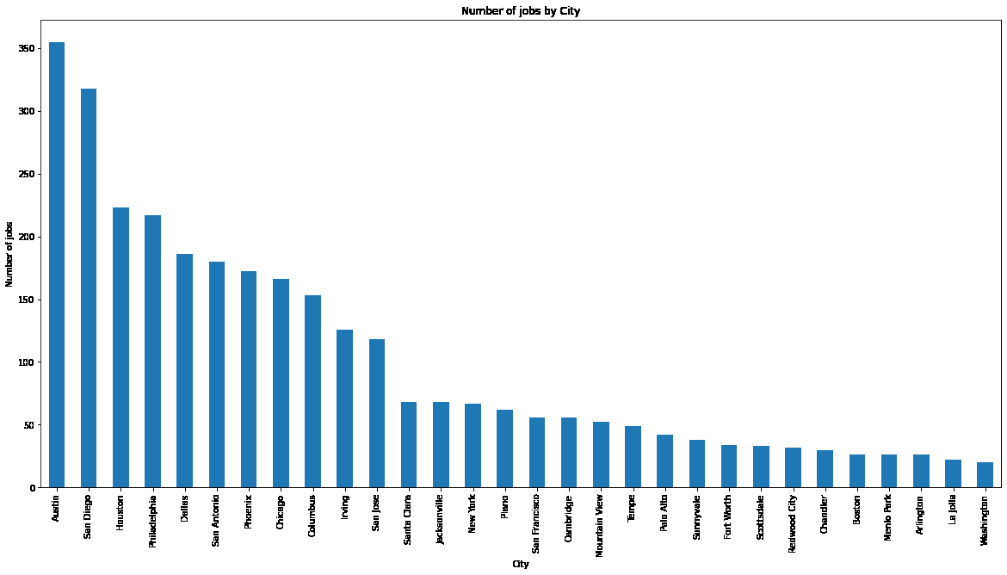
Jobs per Cities (First 30 Cities with more demand)

Slide 8
FL features
The State of Florida has one of the most requested skills -SQL with 0.63 out of a max of 1 and 0.5 in Data Bases knowledge. Python and Math 0.3 and ETL are at 0.2

Slide 9
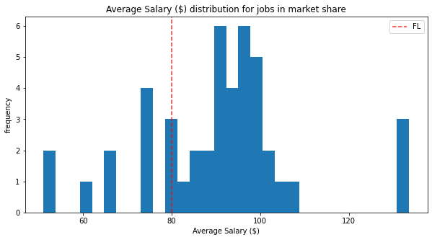
Average Salary in FL respect at USA

Slide 10
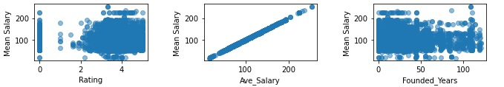
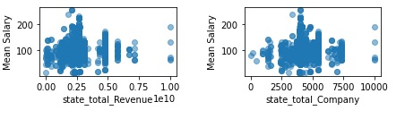
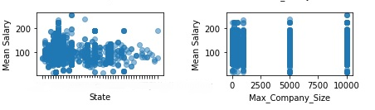
Checking possible relations

Slide 11
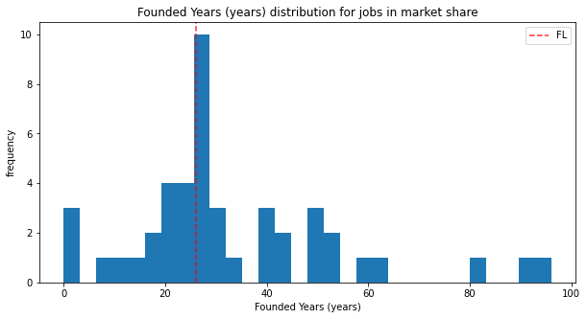
Company seniority in Florida vs. US seniority

Slide 12
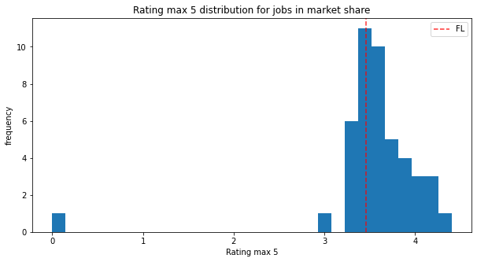
FL rating company vs State’s rating company

Slide 13
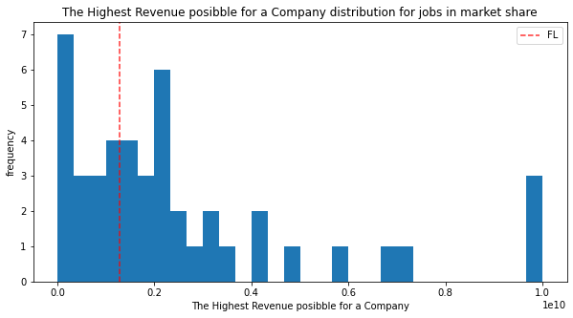
Florida Business Revenue vs. US Business Revenue

Slide 14
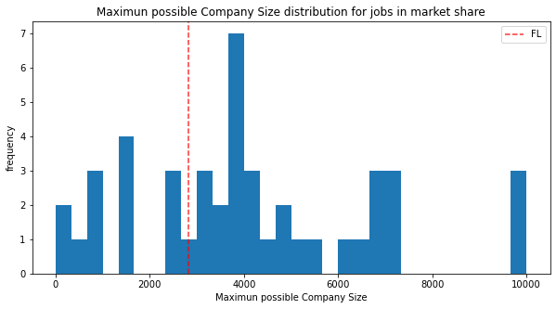
FL company size vs USA company size

Slide 15
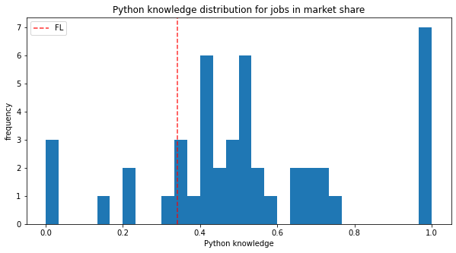
FL Python knowledge vs State’s Python knowledge

Slide 16
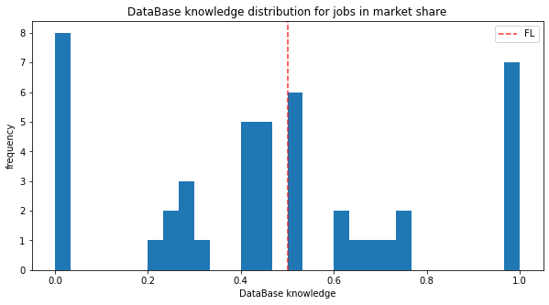
FL DataB knowledge vs State’s DataB knowledge

Slide 17
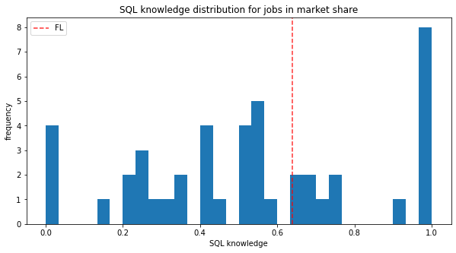
FL SQL knowledge vs State’s SQL knowledge

Slide 18
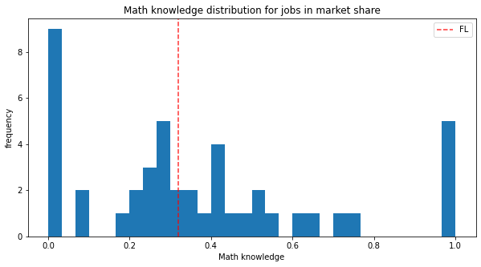
FL Math knowledge vs State’s Math knowledge

Slide 19
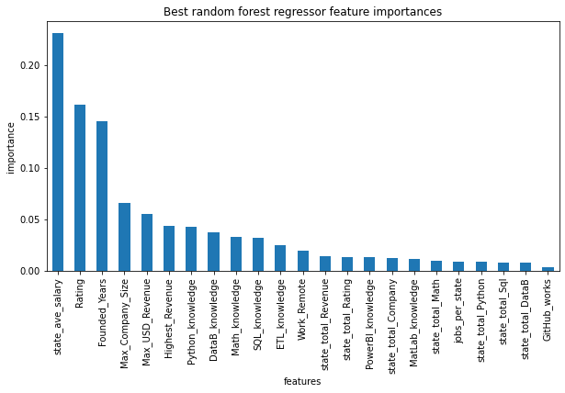

Slide 20
Conclusions:
We can apply this model to any state in the USA
The median salary generally rises in the states that offer the most job opportunities.
The years of seniority of the companies, the Rating and the earnings they have annually, are related to each other but have a low relationship with the average salary.
Perhaps emerging technology companies offer more attractive salaries to make their businesses prosper more quickly.
The knowledge skills that companies demand in Python, SQL, DataB, Math are not proportional to the average salary. Perhaps at first it seemed to us that these relationships existed, then we noticed that all companies demand it in some way, some more than others, but on average they are compensated.Personal data science skills will always be important to any business, so I do believe it is very likely that the skills tests for some companies will be more rigorous than others.

